Slide 1

DR. AMBEDKAR INSTITUTE OF TECHNOLOGY
(An Autonomous institution, Aided by Govt. of Karnataka)
Near Jnana Bharathi Campus, Malathahalli, Bengaluru – 560056
MINI PROJECT (18MLP68)
ON
DEVELOPMENT OF SYRINGE INFUSION PUMP
NAME | USN
ABHISHEK CHAKRABORTY | 1DA19ML001
APSARA C | 1DA19ML004
HARSHITHA S | 1DA19ML010
RUCHITA LINGARAJU | 1DA19ML015
SEMESTER – 6th
MINI PROJECT GUIDE: KAMALA C

Slide 2
BRIEF INTRODUCTION
A syringe pump is a precision based pumping device that can be mounted with one or more syringes for high precision delivery of fluids. Syringe pumps are widely used in medical sector to provide a small but accurate amounts of medications.
Syringe pump settings are used to set the dosage in ml for the required fluids to be delivered to patient as per doctor instructions.
We here propose to build an Arduino based syringe infusion pump that can be monitored as well as controlled via doctors and nurses. This syringe pump allows the doctor to set, modify the flow, stop the infusion of pump as per patient response.

Slide 3
AIM AND OBJECTIVE
It ensures delivery of the fluid in desired amounts so as to achieve desired dosages.
Infusion Pumping in Hospitals and Medical Centres
Precision delivery of medication
Ability to remotely start stop infusion
Ability to remotely modify parameters as per patient response
Automatic record keeping of all logs
Easy to Use Device

Slide 4
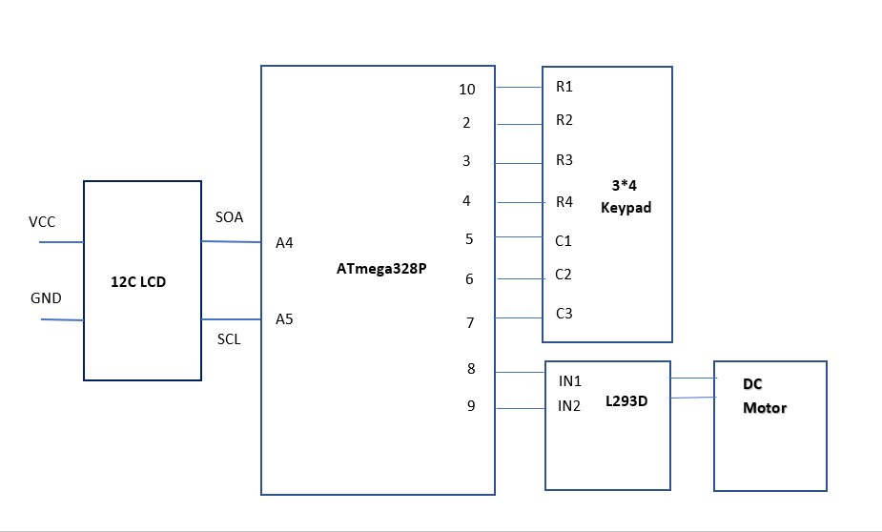
CIRCUIT DIAGRAM

Slide 5
CIRCUIT DIAGRAM
Wiring L293D motor driver IC with Arduino
Connect Vcc1 pin to 5V output on Arduino.
Now, the input and enable pins (ENA, IN1, IN2, IN3, IN4 and ENB) of the L293D IC are connected to six Arduino digital output pins (9, 8, 7, 5, 4 and 3). Note that the Arduino output pins 9 and 3 are both PWM-enabled.
Hooking up an Arduino Uno to an I2C LCD display
You need to connect 4 pins instead of 12. Start by connecting VIN pin to the 5V output on the Arduino and connect GND to ground.
On the Arduino boards with the R3 layout, the SDA (data line) and SCL (clock line) are on the pin headers close to the AREF pin. They are also known as A5 (SCL) and A4 (SDA).

Slide 6
COMPONENTS USED
ARDUINO UNO
DC MOTOR
LCD DISPLAY
DC MOTOR DRIVER
KEYPAD
12V ADAPTER
CONNECTING WIRES
SYRINGE
RACK AND PINION

Slide 7
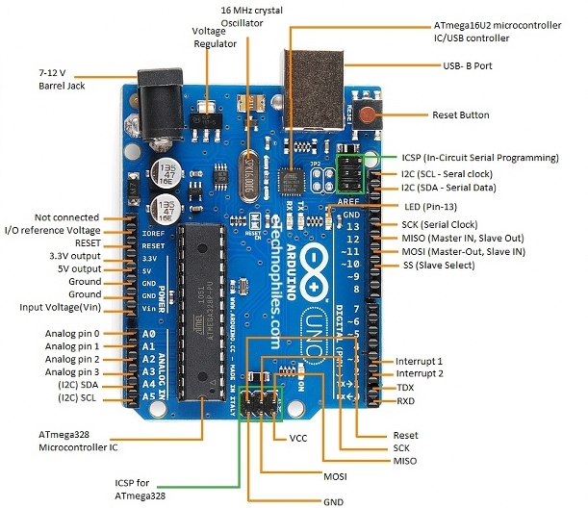
ARDUINO UNO
An Arduino board is a one type of microcontroller based kit.
It consists of 14-digital i/o pins. Wherein 6 pins are used as pulse width modulation o/ps and 6 analog i/ps, a USB connection, a power jack, a 16MHz crystal oscillator, a reset button, and an ICSP header.

Slide 8
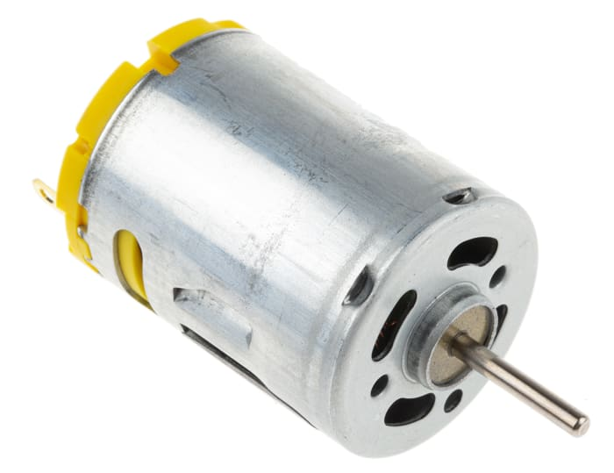
DC MOTOR
DC Motor converts Electrical Energy into Mechanical Energy.
A direct current (D C) motor is a fairly simple electric motor that uses electricity and a magnetic field to produce torque, which turns the rotor and hence give mechanical work.

Slide 9
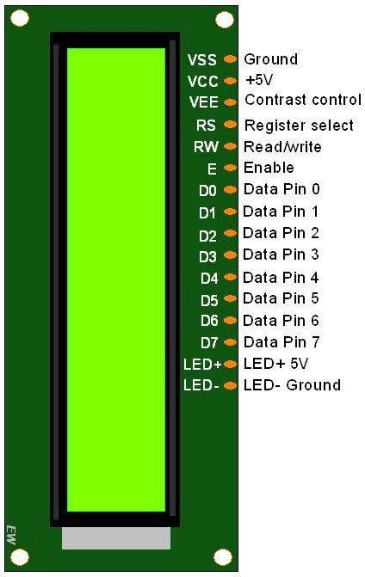
LCD DISPLAY
LCD stands for liquid crystal display.
They come in many sizes 8x1 , 8x2 , 10x2 , 16x1 , 16x2 , 16x4 , 20x2 , 20x4 ,24x2 , 30x2 , 32x2 , 40x2 etc .
Many multinational companies like Philips, Hitachi, Panasonic make their own special kind of lcd's to be used in their products.
All the lcd's performs the same functions (display characters numbers special characters ASCII characters etc).
Their programming is also same and they all have same 14 pins (0-13) or 16 pins (0 to 15).

Slide 10
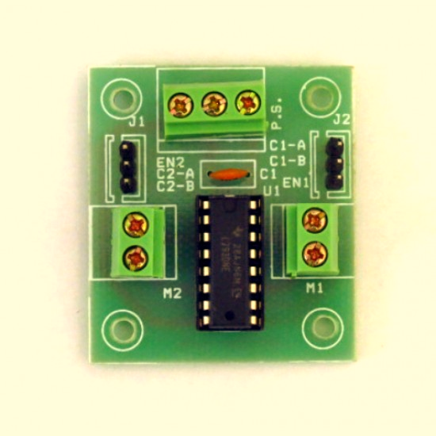
DC MOTOR DRIVER
L293D Motor Driver is used
The L293D is a dual-channel H-Bridge motor driver capable of driving a pair of DC motors or one stepper motor.
The L293D motor driver IC actually has two power input pins viz. ‘Vcc1’ and ‘Vcc2’.
‘Vcc1’ is used for driving the internal logic circuitry which should be 5V.
From ‘Vcc2’ pin the H-Bridge gets its power for driving the motors which can be 4.5V to 36V. And they both sink to a common ground named GND.
The L293D motor driver’s output channels for the motor A and B are brought out to pins OUT1, OUT2 and OUT3, OUT4 respectively.

Slide 11
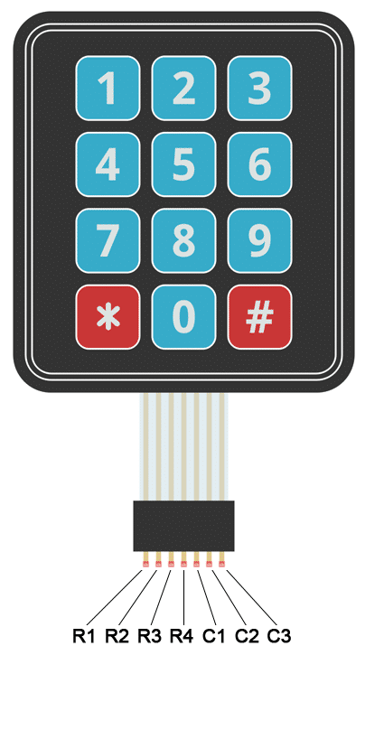
KEYPAD
Pressing a button shorts one of the row lines to one of the column lines, allowing current to flow between them.
For example, when key ‘4’ is pressed, column 1 and row 2 are shorted.
Microcontroller sets all the column and row lines to input.
Then, it picks a row and sets it HIGH.
After that, it checks the column lines one at a time.
If the column connection stays LOW, the button on the row has not been pressed.
If it goes HIGH, the microcontroller knows which row was set HIGH, and which column was detected HIGH when checked.
Finally, it knows which button was pressed that corresponds to detected row & column.

Slide 12
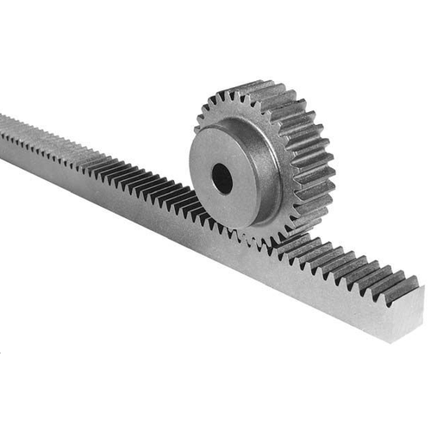
RACK AND PINION
This pinion will be connected with DC motor.
The pinion will help to move the rack attached with it.
Thus it helps in pushing the piston of the syringe.

Slide 13
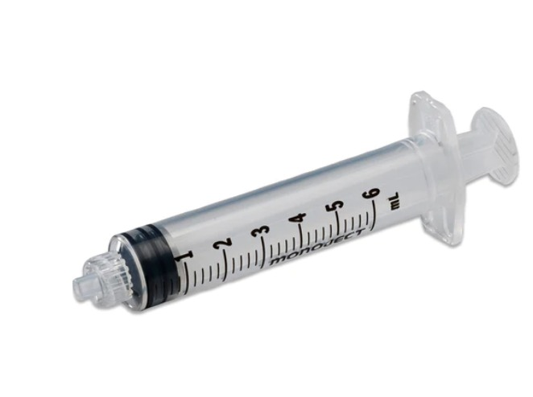
SYRINGE
6ml Syringe is used.
Piston will be connected with the rack which will push it.
Fluid inside the syringe will be pushed out.

Slide 14
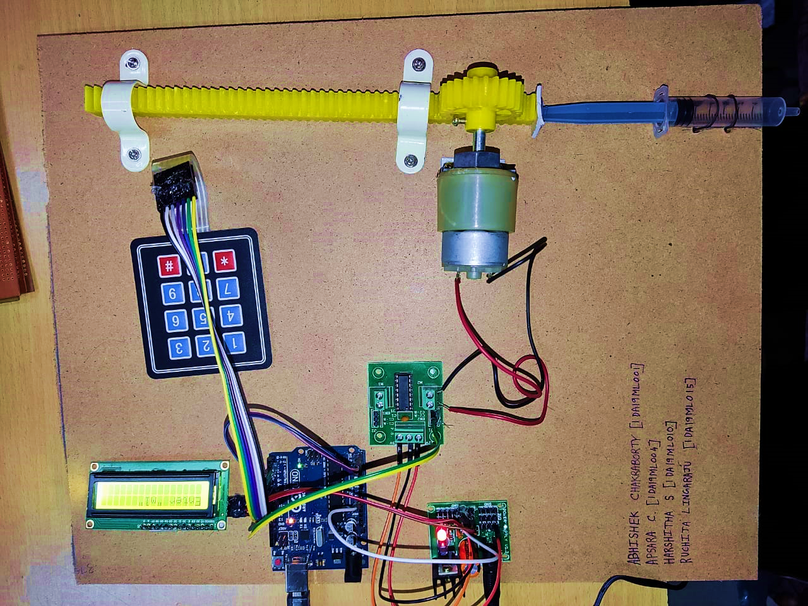
WORKING CIRCUIT

Slide 15
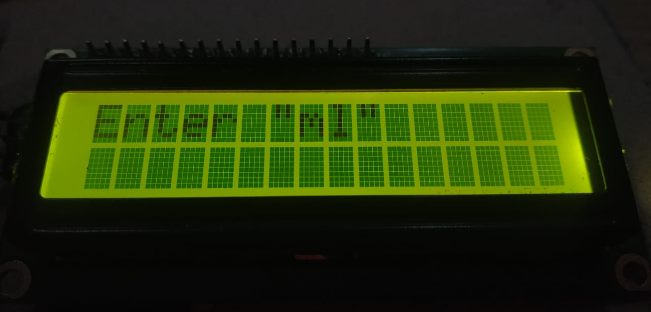
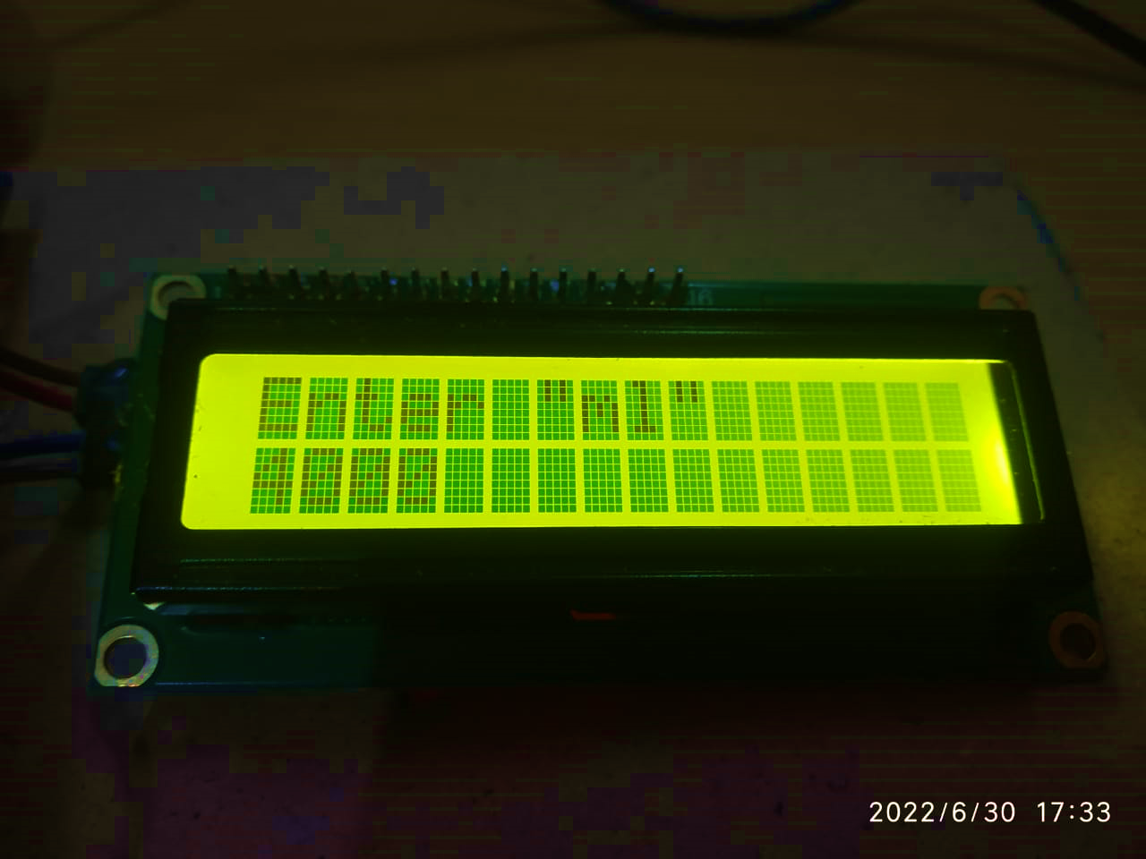
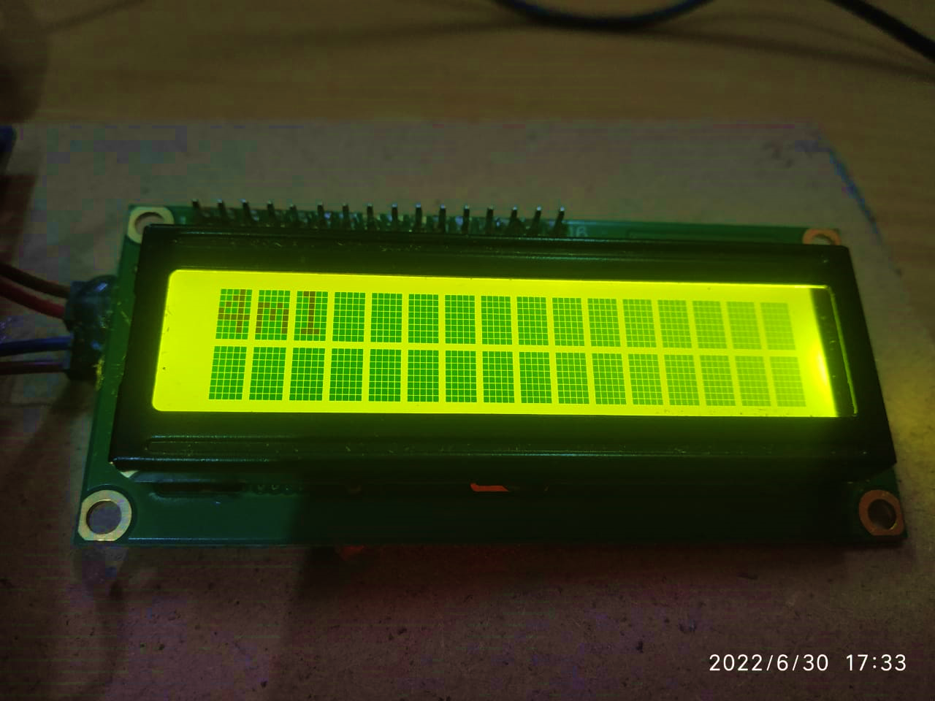
RESULT
Once Arduino connected to laptop, LCD will glow and will show “Welcome”.
‘Enter “ml”’ will be displayed.
After typing 1000 using keypad, the piston will push 1ml .
SL.NO. | NUMBER ENTERED BY KEYPAD | PISTON WILL BE PUSHED (ml)
1 | 1000 | 1
2 | 2000 | 2
3 | 3000 | 3
4 | 4000 | 4
5 | 5000 | 5
6 | 6000 | 6

Slide 16
REFERENCES
Nour Merhi , Nour Mohamad , George HajjMoussa , Ahmad ElSayed , Saeed H. Bamashmos , Lara Hamawy, Mohamad HajjHassan, Mohamad Abou Ali & Abdallah Kassem, ‘An Intelligent Infusion Flow Controlled Syringe Infusion Pump’, pp.48-52
Sakthivel Sankaran, J.Deny, M Pallikonda Rajasekaran, Vishnuvarthanan Govindaraj, Rameeze Raja Mahaif, Abinaya Srinivasan, Sanjai Lakshmanasamy , P2019, ‘Design and Development of a Low Cost, Smart Infusion Pump to Deliver Medications for Patients using Labview Interface With Arduino’, IJEAT, pp. 753-758
Erin Quattromani, Margaret Hassler, Nikki Rogers, Jennifer Fitzgerald and Paula Buchanan” Smart Pump App for Infusion Pump Training” Clinical Simulation in Nursing, Volume 17, pp 28-37.Doi:org/10.1016/ j.ecns.2017.11.004.
C. Luca, D.Andritoi, C.Corciova, R.Ciorap, “ Study on the influence of wireless communication Technology on infusion pumps 2016 International Conference and Exposition on Electrical and Power Engineering (EPE 2016), 20-22 October, Iasi, Romania.
THANK YOU

